Slide 1
AI applications in Finance
Lecture 6
Introduction to Neural Networks
10-Dec-2020
Indranil Dutta

Slide 2
Recap
Network Design
Approximation Network
Predict a value
Scaling, Perceptron and Un-scaling layers
Classification Network
Put into buckets – 2 buckets (yes or no) or multiple
Scaling, Perceptron and Probabilistic.
Type of errors
Testing error
Selection error
Best generalization and network architecture when both errors are minimum

Slide 3
Recap
How to get the right number of inputs
Look at correlation of candidate variables
Growing the inputs
Pruning the inputs
Use Genetic Algorithms
Metrics of ‘relevance’ measure
Precision – Of all the objects retrieved how many are correct
Recall – Out of all correct objects how many are retrieved.

Slide 4
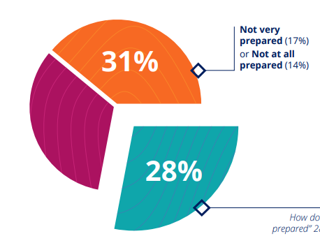
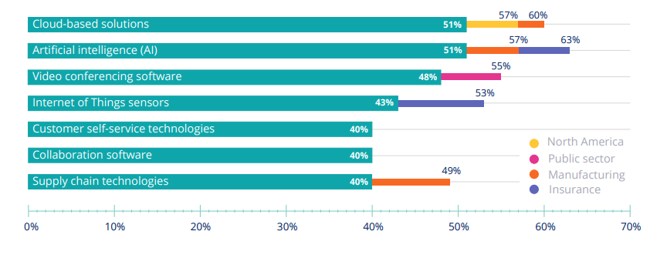
Fun Fact(s) :
Source: https://www.pega.com/system/files/resources/2020-10/pega-future-of-work-report.pdf

Slide 5

Fun Fact(s) :
Source : https://www.pega.com/system/files/resources/2020-10/pega-future-of-work-report.pdf

Slide 6
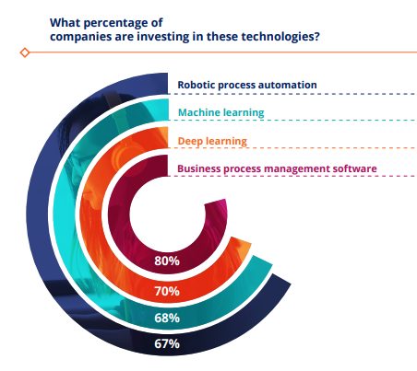
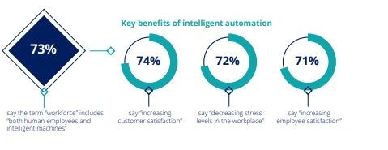
Fun Fact(s) :
Source: https://www.pega.com/system/files/resources/2020-10/pega-future-of-work-report.pdf

Slide 7
Agenda – Session 6
Self Organizing Maps
Case studies through Excel

Slide 8
Course Roadmap

Slide 9
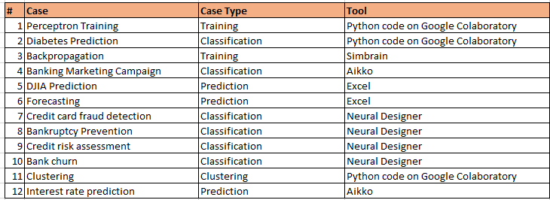
Cases & Tools

Slide 10
Self Organizing Maps

Slide 11
Self Organizing Map - Introduction
Introduced by Kohonen.
Used for clustering – unsupervised learning
Used for information ‘reduction’
Self organizing – ability to learn by itself
Map – a graphical illustration of belonging / cluster.

Slide 12
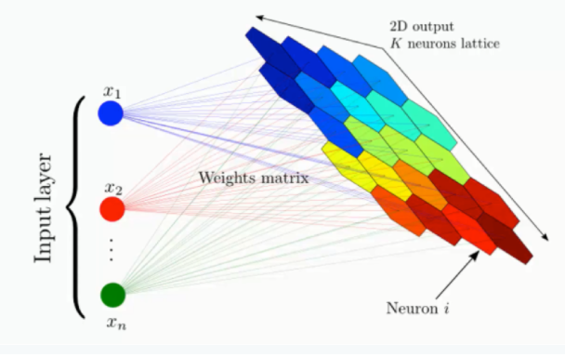
Self Organizing Map - Introduction
Used for reducing ‘Dimensionality’
Input layer -> lots of features
Output layer -> 2 dimensions
Lattice or grid of nodes
SOM
Gets input data set
Classifies this on its own.
Source: https://www.superdatascience.com/blogs/the-ultimate-guide-to-self-organizing-maps-soms

Slide 13
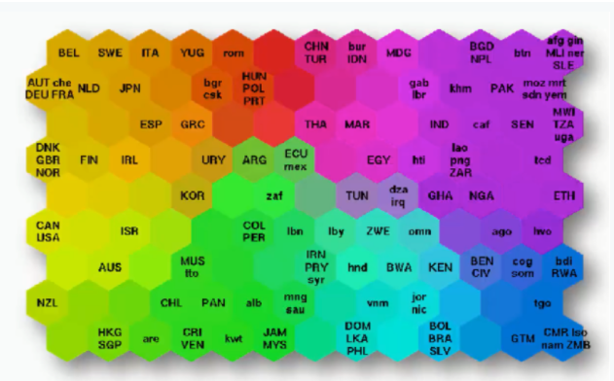
Self Organizing Map - Example
Cluster of countries
Based on inputs (~40)
health conditions
average income per capita
quality of education etc.
Source: https://www.superdatascience.com/blogs/the-ultimate-guide-to-self-organizing-maps-soms

Slide 14
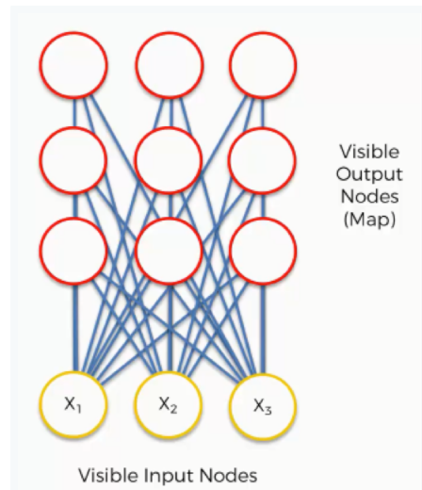
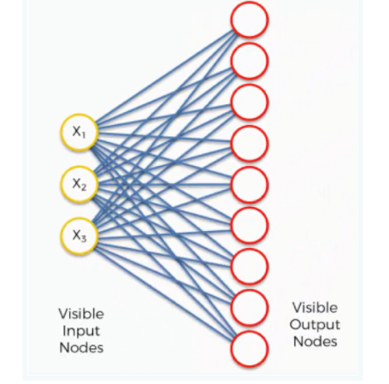
Self Organizing Map – How does learning take place?
Set Up
Input -> 3 features (nodes)
Dataset of 3 columns but 1000s of rows.
Output -> 9 nodes
Always a 2 dimensional grid.
Another view
Source: https://www.superdatascience.com/blogs/the-ultimate-guide-to-self-organizing-maps-soms

Slide 15
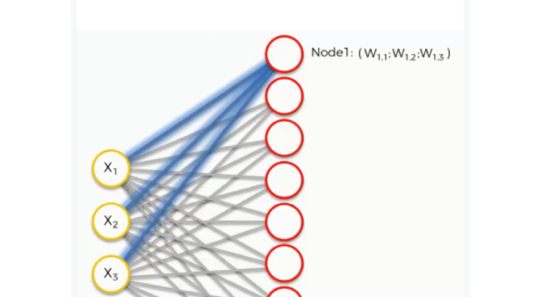
Self Organizing Map – How does learning take place?
Nodes & Weights
Connections are as shown
Weights belong to the output nodes
No activation function
Weights are like coordinates of output nodes
Next Step
Each input row is taken
Output node closest to it is found
Distance calculation -> √ (x₁ - w ₁ ₁) ² + (x₂ - w ₁ ₂) ² + (x₃ w ₁ ₃) ²
Calculation is done node wise
The lowest value node is called the best matching unit (BMU)
This node is the closest to the first row of the dataset.
Source: https://www.superdatascience.com/blogs/the-ultimate-guide-to-self-organizing-maps-soms

Slide 16
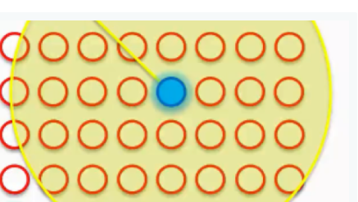
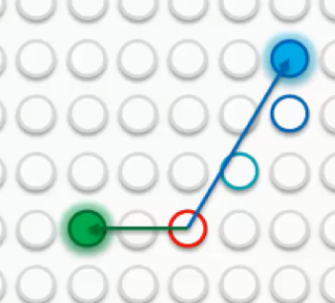
Self Organizing Map – How does learning take place?
Can only change the weights, so
SOM will update weights to be similar to the first row
Does this by having a circle round the BMU
Weights for nodes closest to the BMU change most
Then Process next row
This can give a new BMU
Circle drawn around this BMU
Weights adjusted again.
In Processing
A node can come under influence of two BMUs or more
Change in its weight is a combination of these BMUs.
The circle becomes smaller for each BMU after each row is processed.
Source: https://www.superdatascience.com/blogs/the-ultimate-guide-to-self-organizing-maps-soms

Slide 17
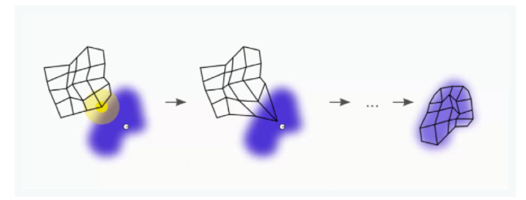
Self Organizing Map – How does learning take place?
So after going through all rows
Each node gets to be a BMU.
The map represents the data set.
Source: https://www.superdatascience.com/blogs/the-ultimate-guide-to-self-organizing-maps-soms

Slide 18
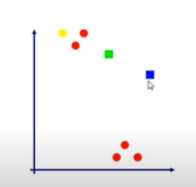
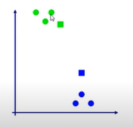
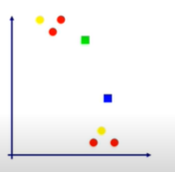
Self Organizing Map – Example
2 neurons
6 inputs
Process
Select random input
Compute winner neuron
Update neuron
Repeat for all input data
Classify data
Source: https://www.youtube.com/watch?v=H9H6s-x-0YE

Slide 19
Self Organizing Map – Characteristics
Maintain structure and interrelationship of incoming dataset.
Relations that are not easily visible can be discovered.
Data is categorized without the need of supervision.
There is no need for target vectors or methods like backpropagation.
Lateral connections exist between nodes.
Source: https://www.superdatascience.com/blogs/the-ultimate-guide-to-self-organizing-maps-soms

Slide 20
Self Organizing Map – Parameters
Learning rate
Decides on the amount of change in each change.
Decreases with each iteration.
Influence rate
Decides the radius of the circle
Decreases with each iteration.
Source: https://towardsdatascience.com/self-organizing-maps-for-dimension-reduction-data-visualization-and-clustering-ff966edd311c

Slide 21
Self Organizing Maps Example through Code

Slide 22
Self Organizing Map – Code Example
Get the Math module
Defining a class for the SOM
Basically a blue print for creating objects
Example is a plan to build a house.
Blue print can have
Actions through functions
Storage of data through variables
Source: https://www.geeksforgeeks.org/self-organising-maps-kohonen-maps/

Slide 23
Self Organizing Map – Code Example
Two functions or actions
Winner
Set the distance variables to zero.
Calculate the distances
Return the results
Update
Changing the weights (self update of SOM)
Takes the BMU, sample, weights, learning rate
Source: https://www.geeksforgeeks.org/self-organising-maps-kohonen-maps/

Slide 24
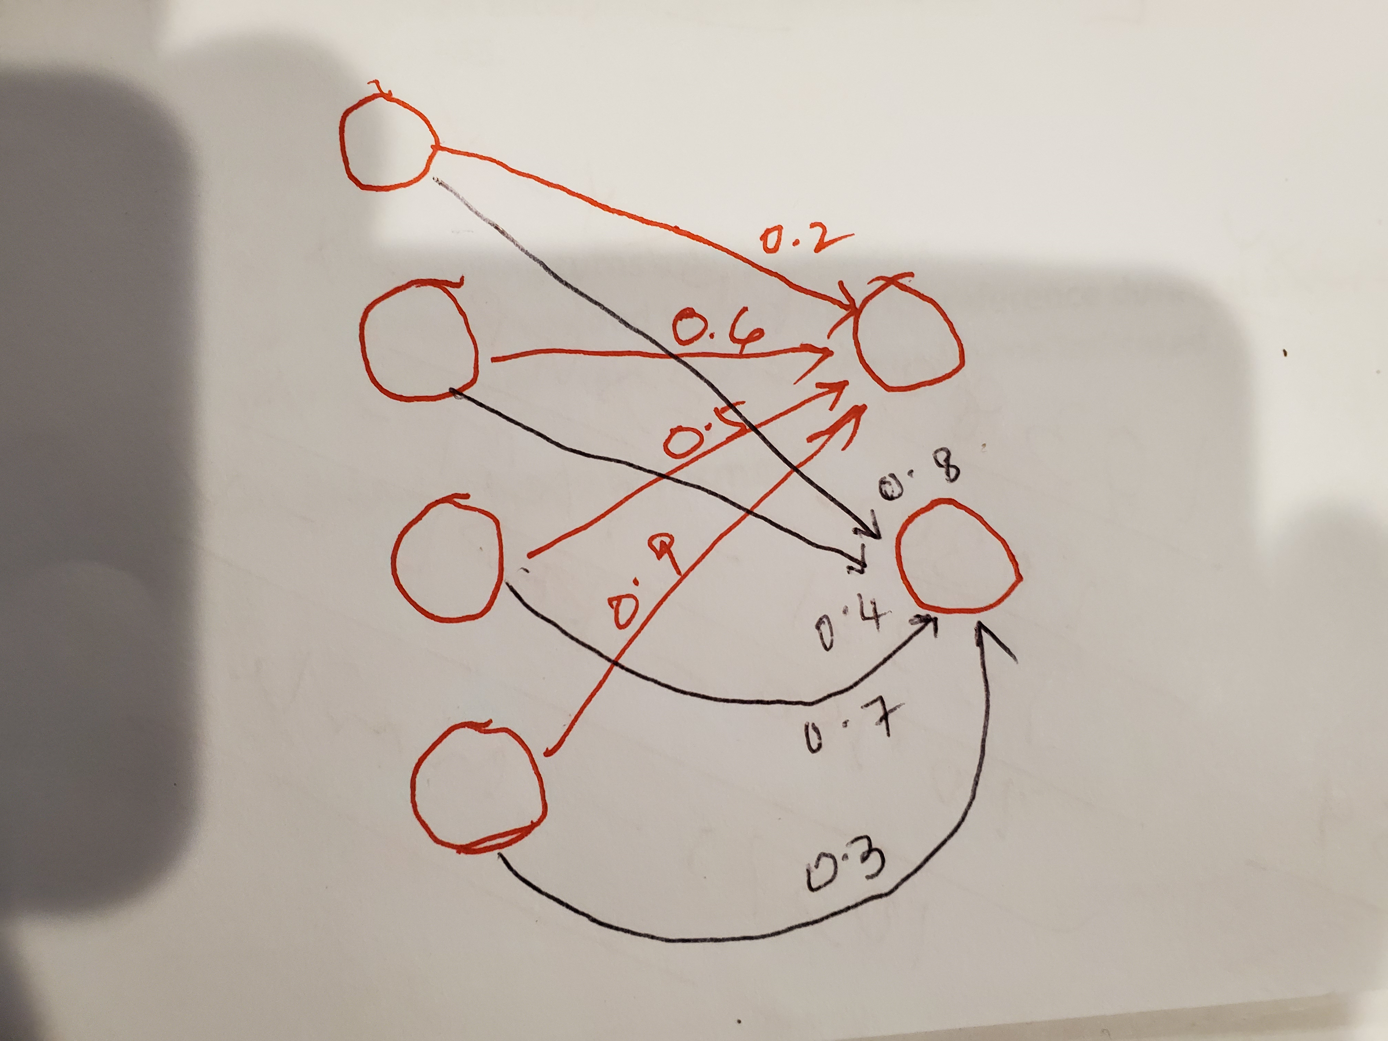
Self Organizing Map – Code Example
Processing
Get the training example
Initialize the weights
Create the SOM
Train the network
For each pass through the set
Get a sample row
Get a winner node
Update weights in the SOM
Classify a sample
Get the closest node in the SOM
Represents a cluster.
Source https://www.geeksforgeeks.org/self-organising-maps-kohonen-maps/

Slide 25
Self Organizing Maps Example through Simbrain

Slide 26
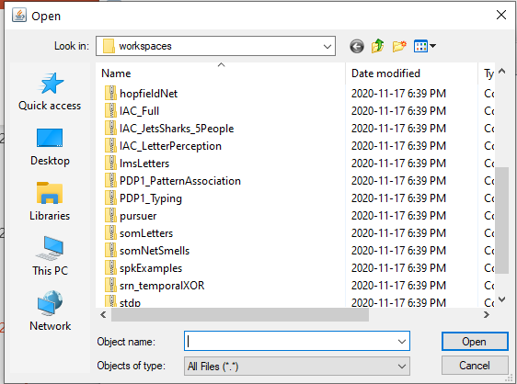
Self Organizing Map – Example using Simbrain
Example is clustering of alphabet samples
Source: simbrain.net

Slide 27
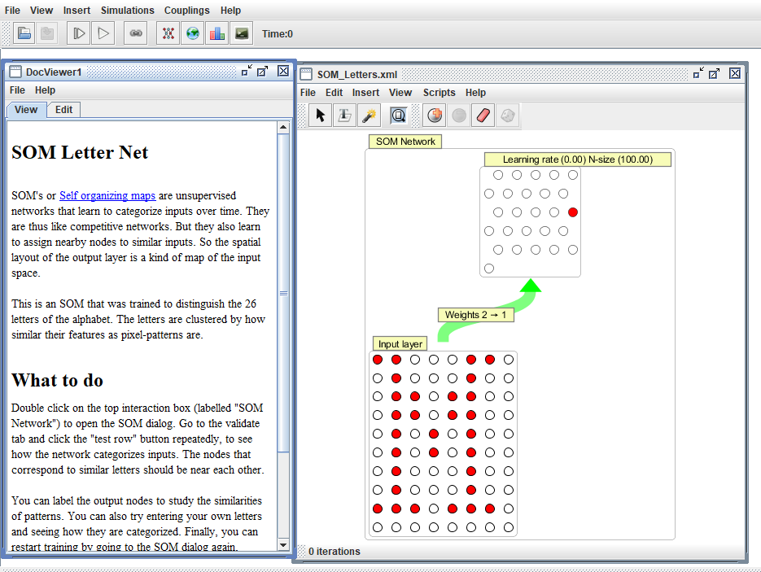
Self Organizing Map – Example using Simbrain
Source: simbrain.net

Slide 28
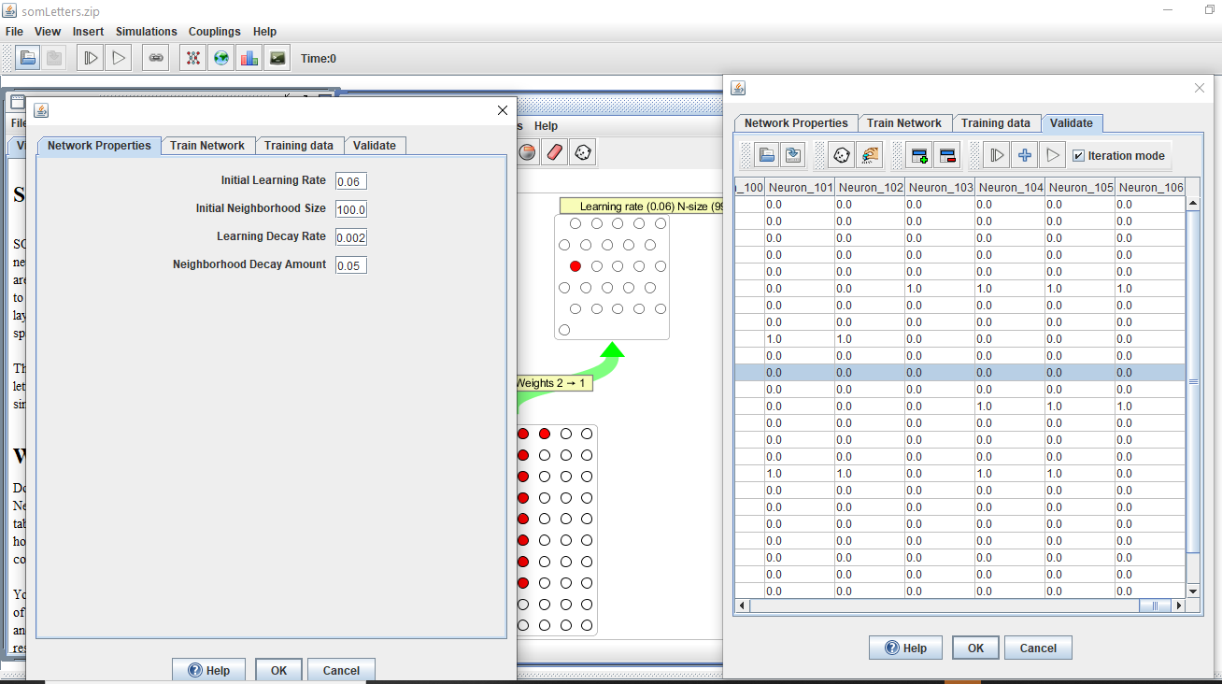
Self Organizing Map – Example using Simbrain
Source: simbrain.net

Slide 29
Session summary -------------------------------------------------------------
Self Organizing Maps (keywords)
Reduce dimensionality
Project on a map
Unsupervised learning
Discover relationships

Slide 30
References -------------------------------------------------------------
www.geeksforgeeks.org/self-organising-maps-kohonen-maps/
https://www.pega.com/
https://superdatascience.com
https://www.youtube.com/watch?v=H9H6s-x-0YE
https://towardsdatascience.com/self-organizing-maps-for-dimension-reduction-data-visualization-and-clustering-ff966edd311c
https://simbrain.net/

Slide 31
Topics for next session
Neural Networks – Concepts and Practical examples

Slide 32
End of Session ------------------------------------------------------------------ Questions

